Slide 1
SAS Customer Intelligence Solution Briefing
SAS Marketing Optimization and SAS Adaptive customer experience
Presented at: Denver SAS User’s Group
Presented by: Carie Whalen

Slide 2
SAS Customer Intelligence
Solution Architecture
Consistent Customer Experience
Channels
Departments
In Person
Call Center
Customer
Experience
Finance
Merchandising
Social
Mobile Online
Marketing
Risk
Customer Service
Direct Mail
Radio TV
Corporate Affairs
Operations
Strategy & Operations Management
Mass & Digital
Direct Marketing
Real/Right Time
Decisions
Event Triggered
Marketing
Record Customer Responses
Decisions
Optimization
Marketing Measurement
Segmentation
Predictive
Modeling
Online Customer
Behavior
Customer Profitability & LTV
Customer Risk / Credit
Social & Network
Analytics
Analytics
Data
Quality
Data
Integration
Data
Model
Metadata
Information
Management
Data
Sources
ERP
CRM
EDW
Online
Social
Other

Slide 3
SAS Marketing Optimization

Slide 4
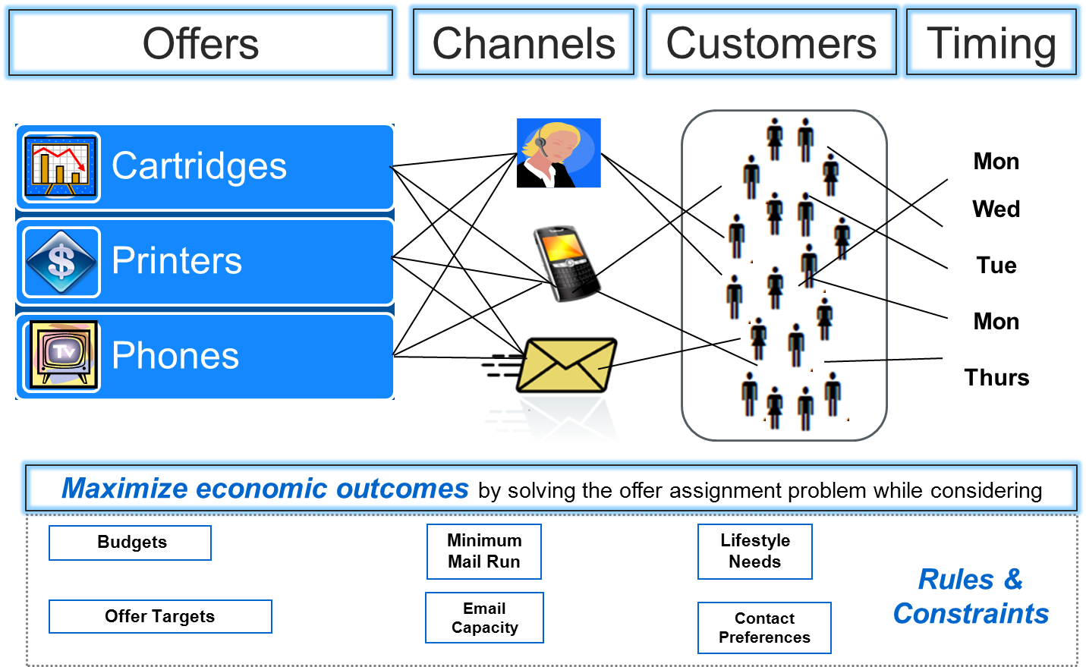
Marketing Optimization
Decisioning Dilemma

Slide 5
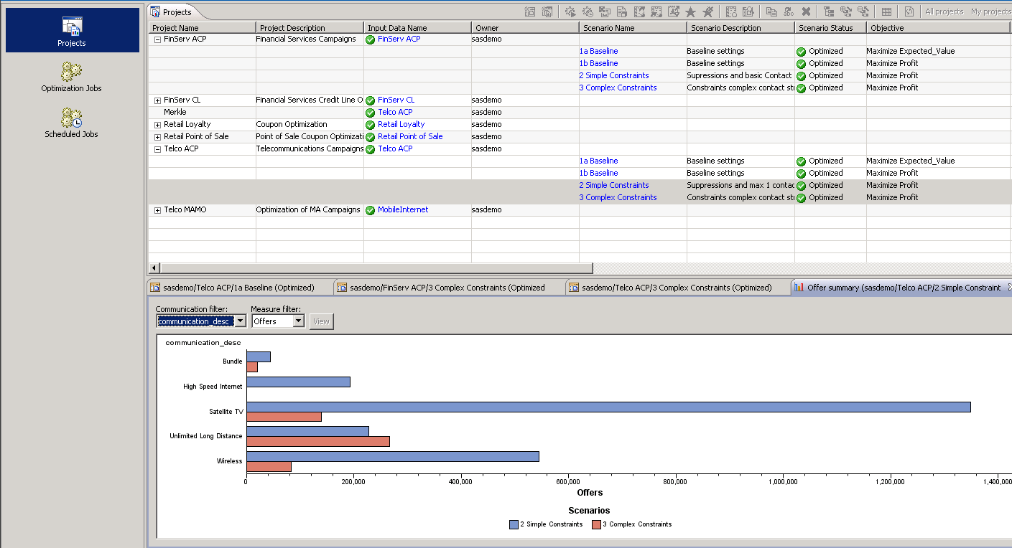
SAS Marketing Optimization
Determines the optimal offers to customers through the right channel at the right time and provides insight into the implications of changing business constraints, such as budget, channel capacity and contact policies resulting in an increased marketing campaign ROI

Slide 6
Traditional Approach
The inputs
Expected Return
An Example Campaign
Phone
All Customers
Printer
Cartridge

Slide 7
Traditional Approach
Prioritization method
Constraints:
Each customer must get an offer from at most one campaign
Each campaign must target at most three customers
Expected Return = $660

Slide 8
Traditional Approach
Customer Optimization
Constraints:
Each customer must get an offer from at most one campaign
Each campaign must target at most three customers
Expected Return = $705

Slide 9
SAS Marketing Optimization
True optimization yields the best results
Constraints:
Each customer must get an offer from at most one campaign
Each campaign must target at most three customers
Expected Return = $775
Customers typically see improvements from 10% - 100%+

Slide 10
SAS Marketing Optimization
When is it Relevant?
Large numbers of target customers
Multiple offers are eligible for each customer
There are underlying business constraints at the offer, customer and channel levels
Complex contact policies need to be satisfied as part of the offer assignment decisions
Want to ensure the maximum possible return from the campaigns

Slide 11
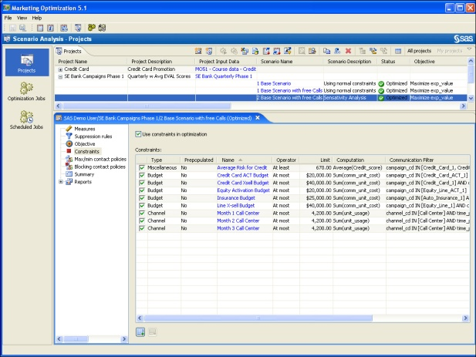
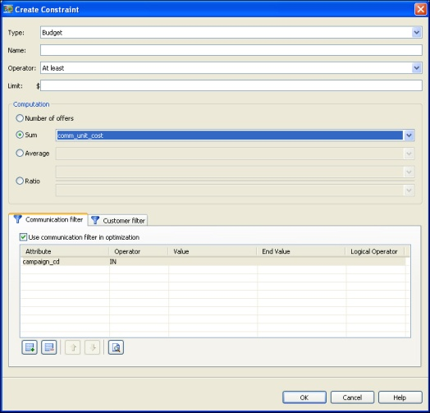
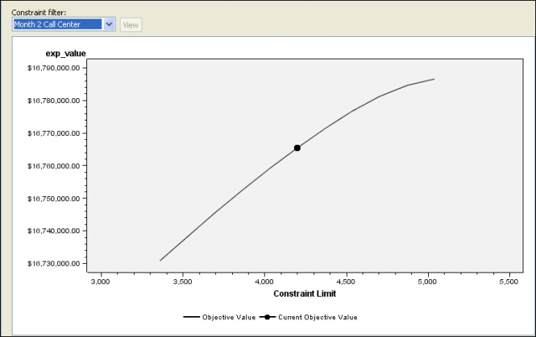
SAS Marketing Optimization
solution for marketers to maximize ROI from campaigns by optimally communicating with each customer while satisfying underlying business constraints and rules
  Highly-scalable solution built using sophisticated analytics & algorithms
  Flexibly define business objectives and constraints
  Incorporate real-world contact policies
  Analyze the sensitivity of business objectives on underlying constraints
  Easily compare scenarios to execute the most desired outcome
  View multiple pre- and post-optimization reports for analysis and publishing
  Integrated with SAS Marketing Automation

Slide 12
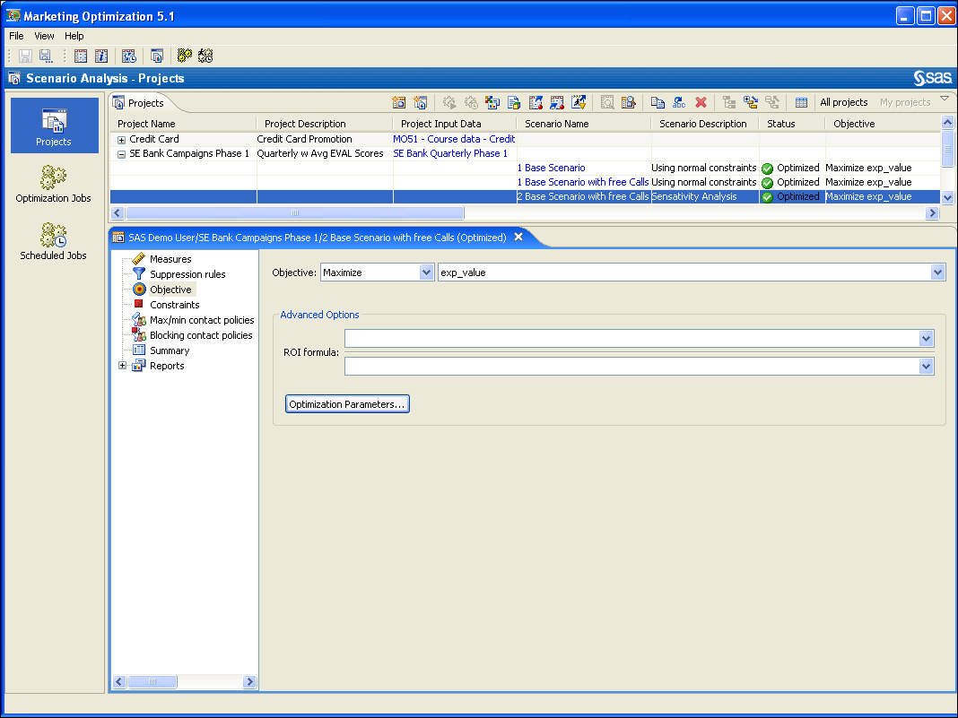
SAS Marketing Optimization
Projects
Project screen enables users to create, edit, and view projects and scenarios

Slide 13

SAS marketing Optimization
Constraints
Create, edit, and review constraints in the scenario editor.

Slide 14
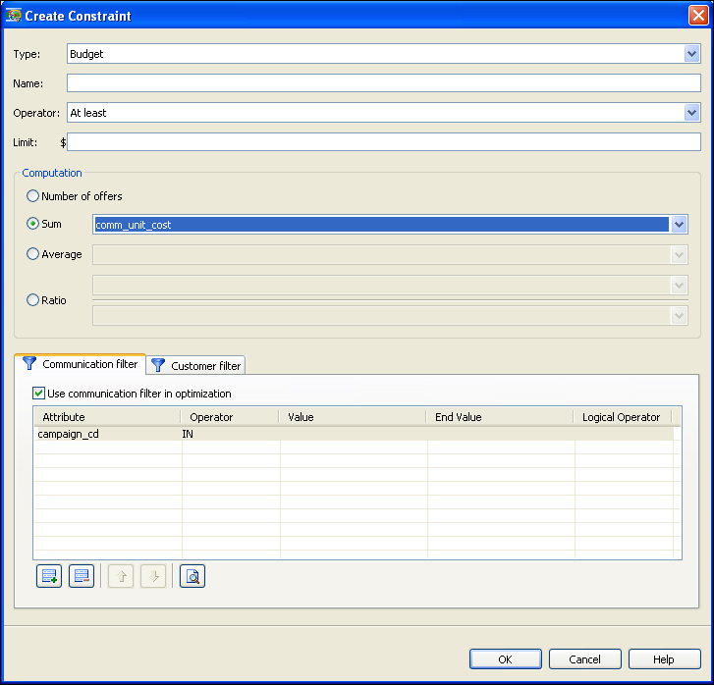
SAS Marketing Optimzation
Constraints
Constraints can be easily defined using drop-down lists

Slide 15
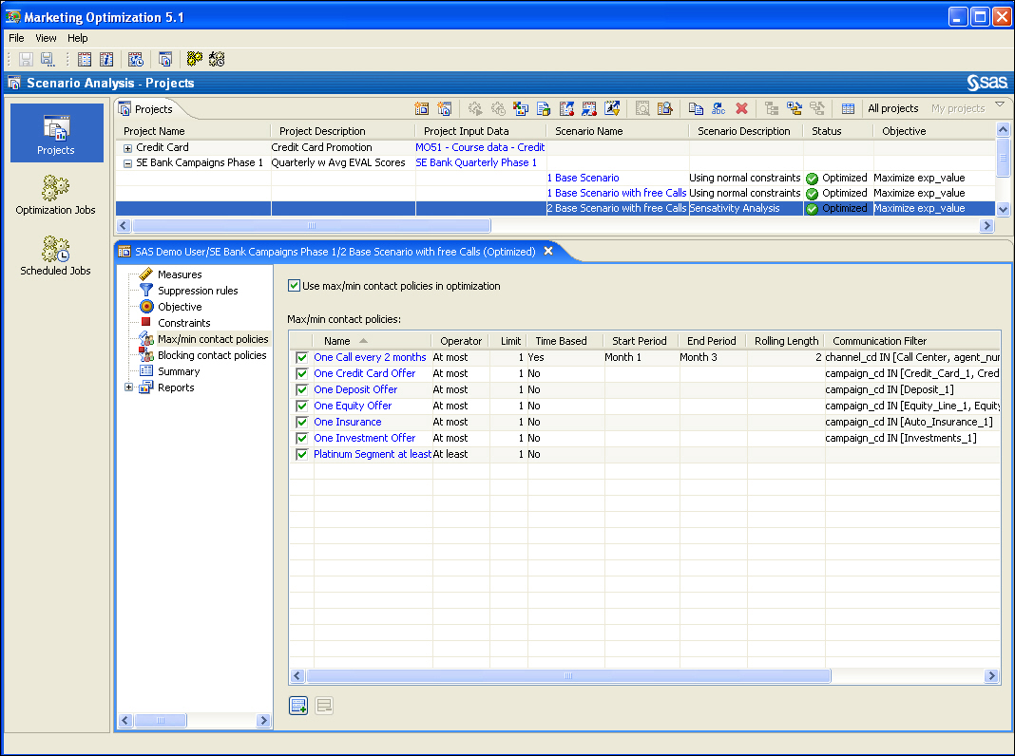
SAS Marketing Optimization
Contact Policy
Define, edit, and review contact policies in the scenario editor.

Slide 16
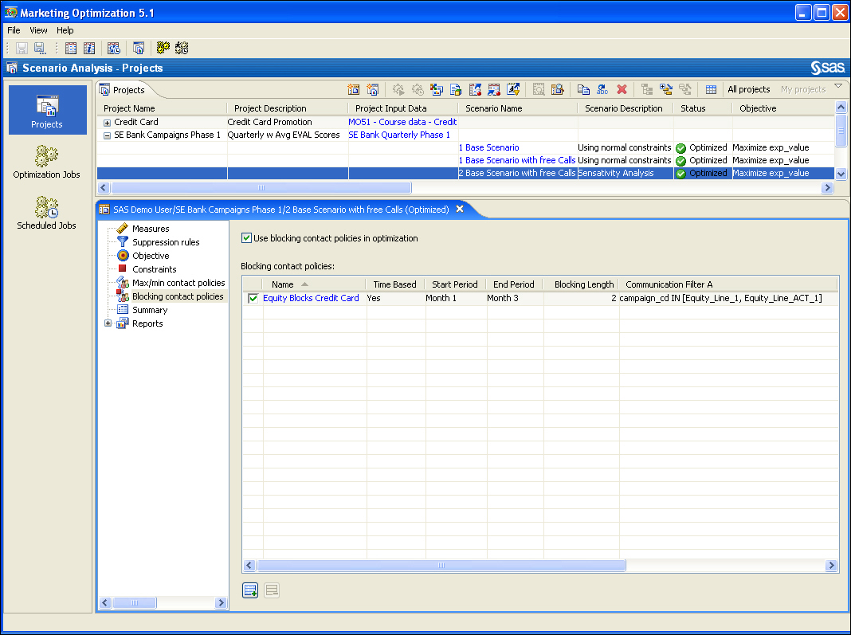
SAS Marketing Optimization
Blocking Policy
Define, edit, and review blocking contact policies in the scenario editor.

Slide 17
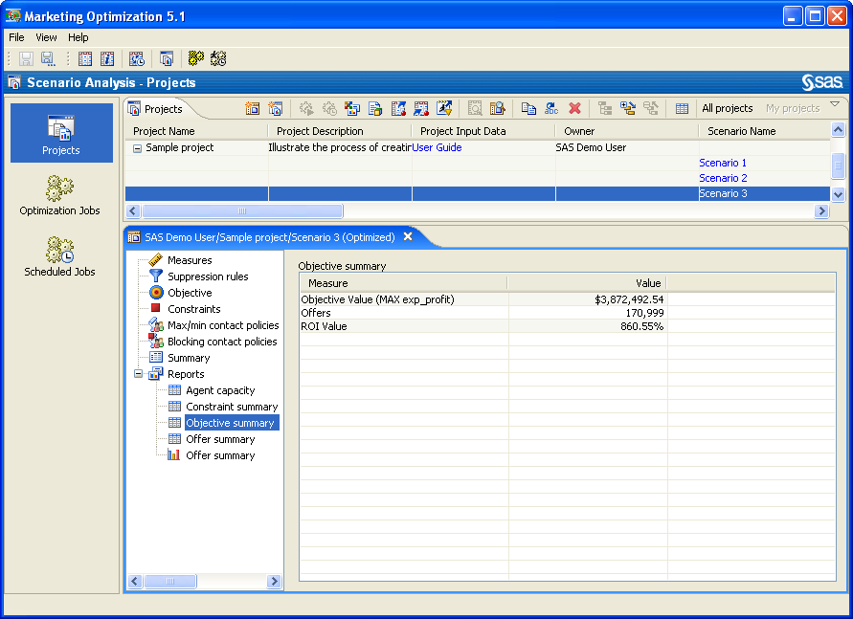
SAS Marketing optimization
Objective Summary Reporting

Slide 18
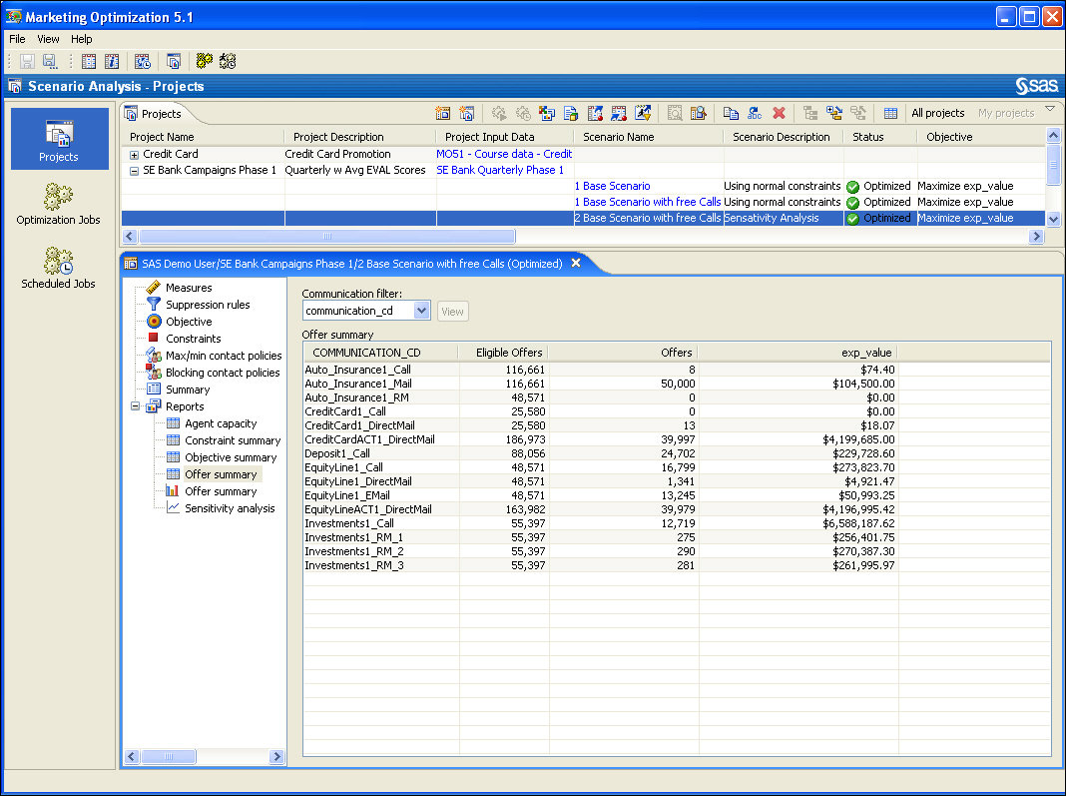
SAS Marketing optimization
Objective Summary Reporting
Review the offers to see the effect of optimization. Note that some campaigns have a large number of offers while others do not.

Slide 19

SAS Marketing Optimization
Sensitivity Graph
The sensitivity graph provides a measure of how much the objective value changes as the limit of the constraint changes in either direction.

Slide 20
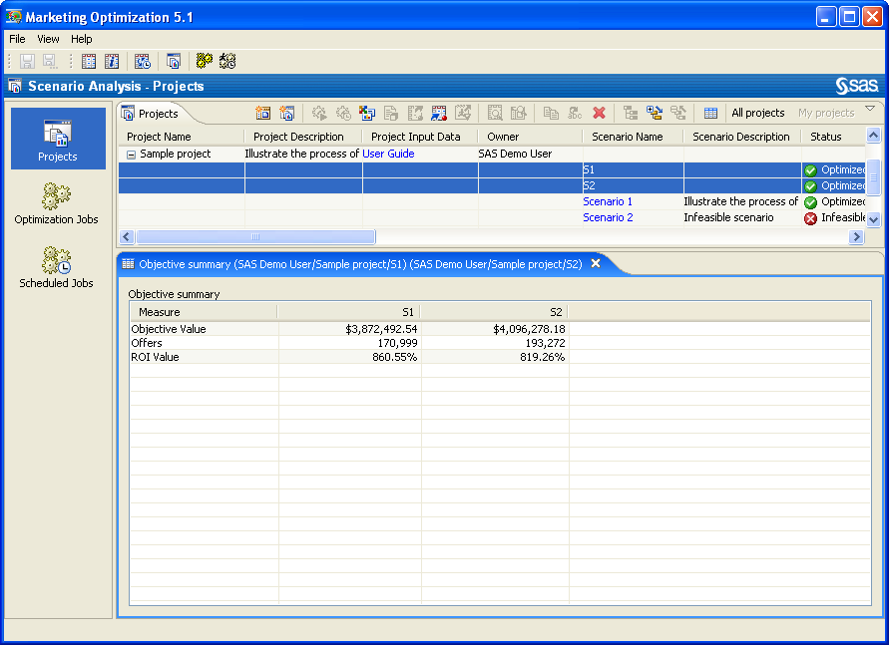
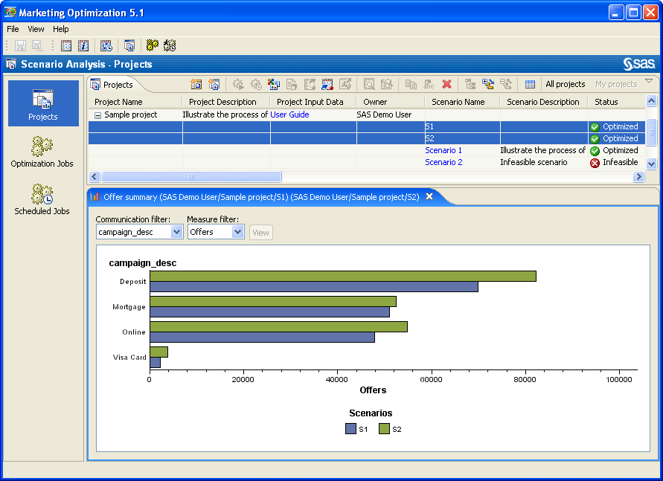
SAS Marketing Optimization
Scenario Comparison Reporting

Slide 21
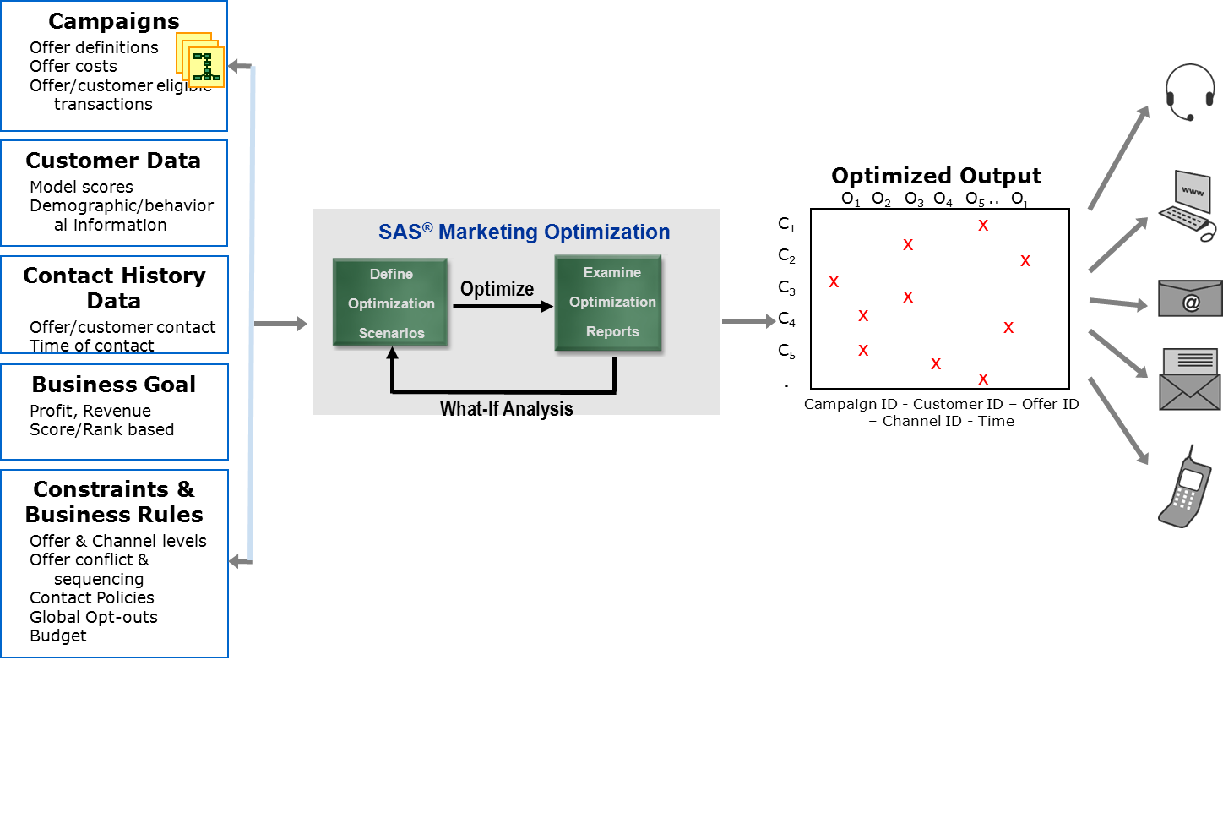
SAS Marketing Optimization
Workflow

Slide 22
SAS Marketing Optimization
Customer Success Examples
Client Name | Benefits
Commerzbank | 55% increase in profitability of DM program Payback in 4 months
Vodafone (Australia) | 3-10x Response Rate increase Improve campaign ROI by 4x 30% reduction in campaign costs
Scotiabank | 50% Campaign ROI improvement
Major Insurer | 12% increase in revenue; 52% in earnings Savings of >$4 million per year
#1 Market Share European Retailer | Individualized targeting of monthly coupon mailers Increased offer response rates Decrease mailing costs

Slide 23
SAS Adaptive customer experience

Slide 24
Omni-Channel
Many industries are seeing a true move to a multi-channel relationship with their customers
  The SAS ACE solution is a set of platform-agnostic analytic tools with the ability to link customer insights across channels and data sources to provide a complete view of the customer and all the interactions they have a company.
Retailer
iPad Applications
Flagship Store
Phone Sales
Main Website
Boutique Microsites
Boutique Stores
Credit Card

Slide 25






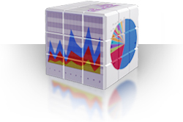




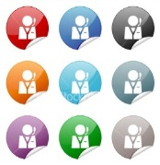
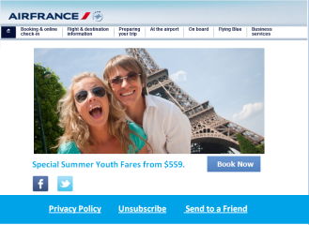
Sas adaptive customer experience
overview
Enhance your
Multi-channel
Data Warehouse
Engage Online & Mobile Visitors
Build an Online
Data Mart
UNDERSTAND
Explore, Analyse, Model and Reports
UNDERSTAND TARGET INTERACT
Track All
Visitor Journeys
Transform Journeys into Insights
TARGET
Multi-channel communication
INTERACT
Real-time Visitor State Drives On-site Messaging
Optimal Personalized Online
Experience
Notes:
Most browsers covered by dynamic tag, including on mobile platforms
Note on mobile Apps: Only Apple (iOS) and Android Apps can be tagged. The latest Blackberry OS is capable of running converted Android Apps, opening up this platform as well in some circumstances.

Slide 26
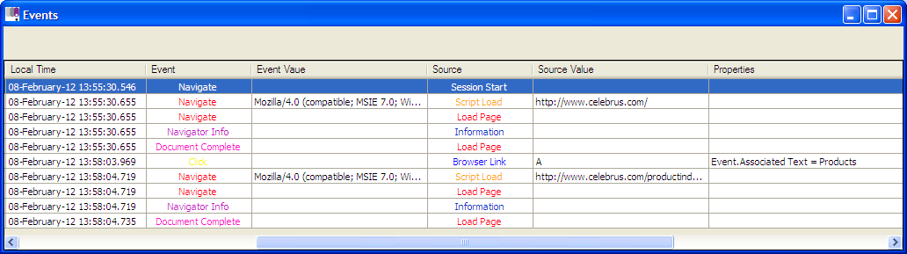
Understand the Consumer
Unique, cross-channel data collection
Real-time, consumer level data
Packaged in real-time and ready for analytics
ENABLES
FULL Consumer Segmentation
Consumer Lifetime Value
Next Best Action
Market Basket Analysis
Predictors of Purchase
ENABLES
Consumer LOYALTY
Greater SPEND
More INTERACTIONS
Easier ACQUISITION
Stronger BRAND

Slide 27
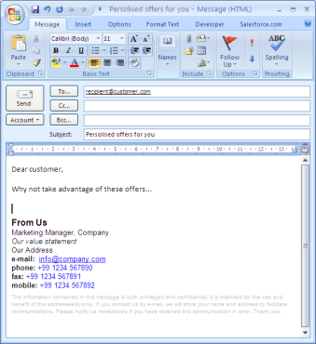
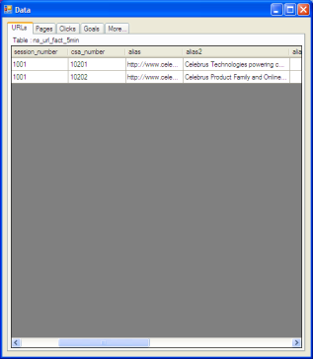

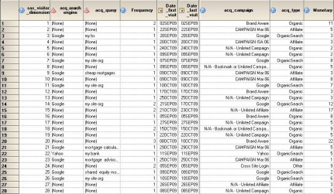
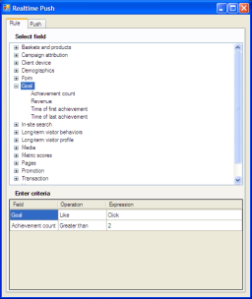
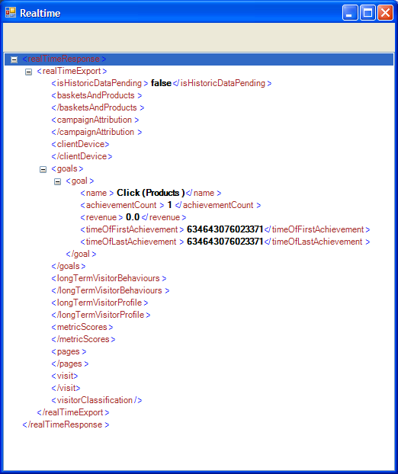
Real Time Omni-Channel Overview
Online Experience across websites and mobile formats
Batch Messaging -
Campaign Management
Consumer View
Analytics and Reporting
Packaging
Data Collection
On-site messaging/
In-Store Messaging –
Real-Time Decisioning
Real time state

Slide 28
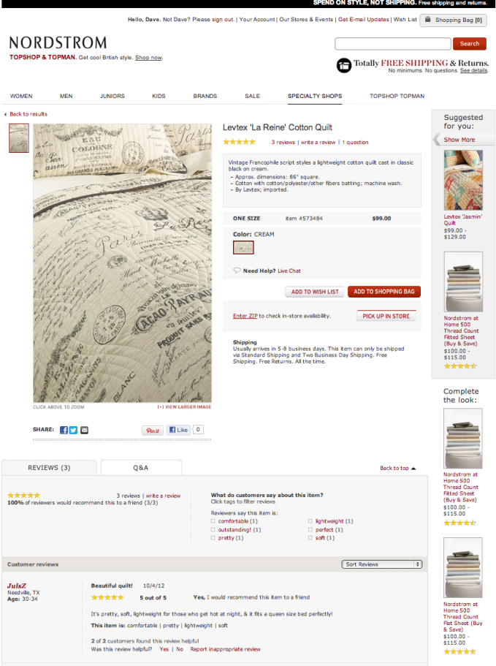
E-Commerce Trends 2012
Adaptive Customer Experience: Targeted Offers
Understand the Customer
Target in Real Time
Personalize the Interaction
SAS analytics can bridge data from online and offline sources to provide recommendations and real-time targeted offers based on real-time analysis of customer behavior. Get a higher response rate to your offers by accurately targeting them at the right consumer at the right time.

Slide 29
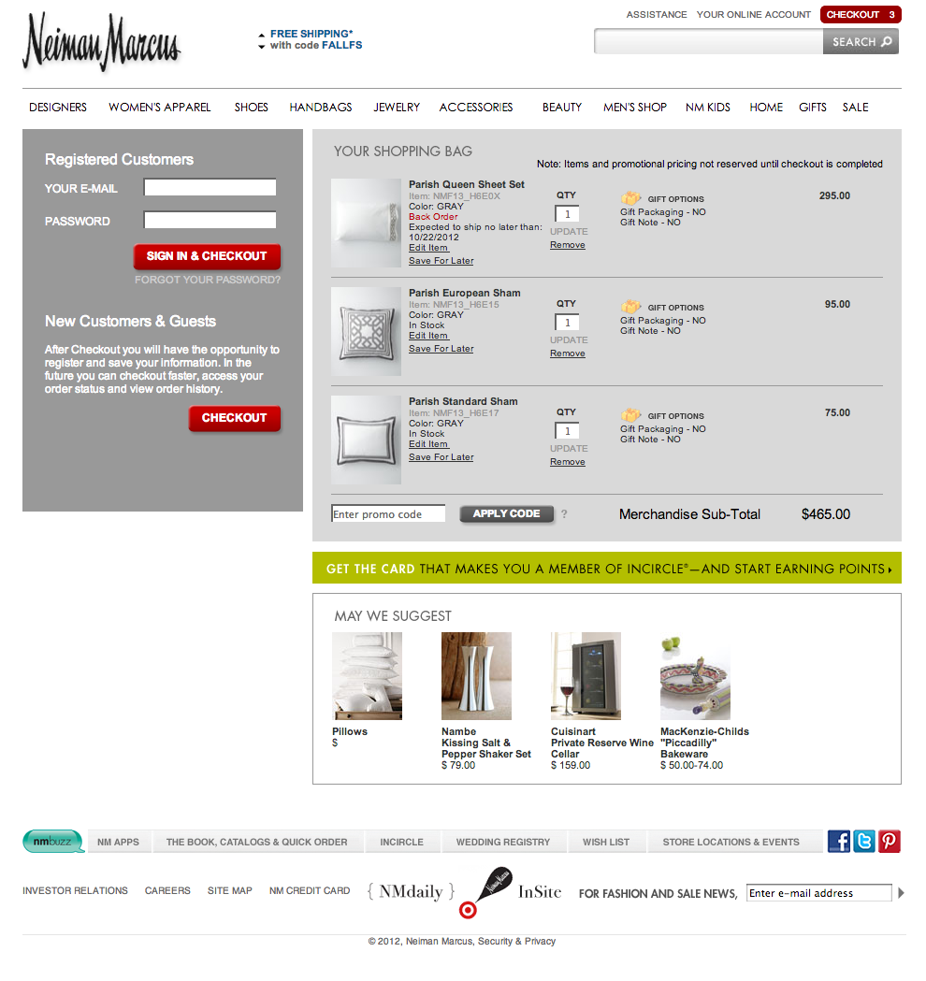
Use Case
Adaptive Customer Experience: Cart Abandonment
Understand the Situation
Decide in Real Time
Personalize the Interaction
SAS analytics can analyze each situation as a customer enters the checkout page and score the likelihood that the transaction will be completed in real time. This capability allows a retailer to present “save-play” style offers to customers in order to convince them to complete their purchase.

Slide 30
Questions?

